Slide 1
GESTURE RECOGNITION BASED INTERACTIVE GAME
Submitted in the partial fulfillment for the award of the degree of
BACHELOR OF ENGINEERING
IN
ARTIFICIAL INTELLIGENCE AND MACHINE LEARNING
Submitted by:
KINSHUK JAGDEV-18BCS6019
KARAN TREHAN-18BCS6033
SHUBHNOOR GILL -18BCS6061
ARGHA SAMANTA-18BCS6065
Under the Supervision of:
Prof. Somsirsa
Department of AIT-CSE
DISCOVER . LEARN . EMPOWER

Slide 2
Outline
Introduction to Project
Problem Formulation
Objectives of the work
Methodology used
Results and Outputs
Conclusion
Future Scope
References

Slide 3
Introduction to Project
Gesture recognition has a significant role to play in human-computer interaction of the future. The user is no longer confined to the desktop for the access of computational resources using gesture recognition based input technologies.
Significant research efforts have been made to replace conventional machine- centered interfaces such as keyboard, mouse and joystick by vision based interfaces.

Slide 4
Introduction to Project (contd..)
We have designed a robust hand gesture recognition system which can efficiently track both static and dynamic hand gestures. Our system translates the detected gesture into actions such as turning left/right, applying brakes, acceleration, etc. in a game.
We build an interactive version of game using a gesture recognition based interface which is more real and exciting to play than the keyboard based game.

Slide 5
Introduction to Project (contd..)
A simple computer vision application was written for the detection and recognition of the gestures and their translation into the corresponding commands for the game.
The appropriate OpenCV functions and image processing algorithms for the detection and interpretation of the gestures were used. Thereafter, the program was tested on a webcam with actual hand gestures in real-time and the results were observed.

Slide 6
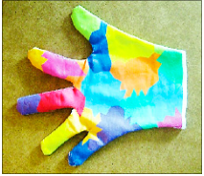
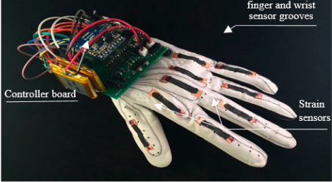
Problem Formulation
Previously, hand gesture recognition was achieved with wearable sensors attached directly to the hand with gloves.
Problem: Wearable sensors and gloves have various limitations that make them unsuitable as sensors may cause skin damage, infection or adverse reactions in people with sensitive skin.
Color-based recognition using glove marker
Sensor-based data glove
(adapted from website: color-based-glove)
(adapted from website:smart-glove)

Slide 7
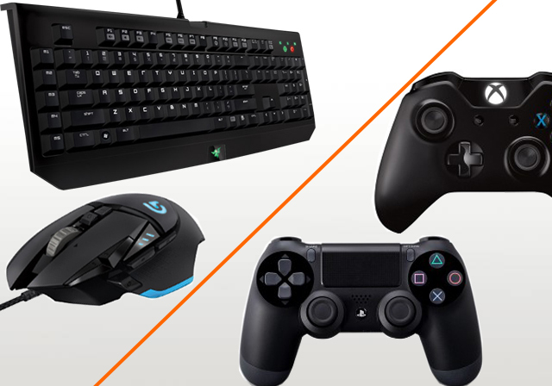
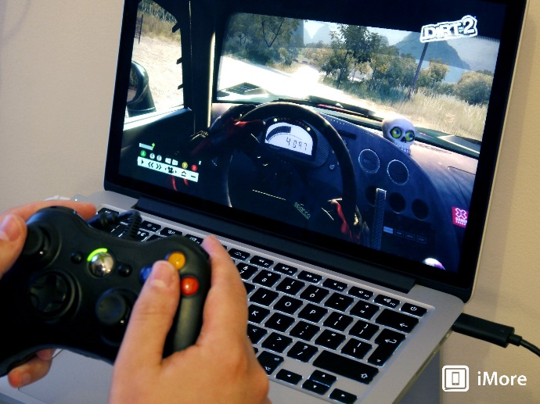
Problem Formulation (contd..)
Mouse and Keyboard are the basic input/output to computers and the use of both of these devices require the use of hands. Most important and immediate information exchange between man and machine is through visual aid.
Problem: The use of a physical controller like mouse, keyboard for human computer interaction hinders natural interface, especially when playing games and are also costly.

Slide 8
Objectives
1. Study and apply the needed tools, namely:
a. The OpenCV Computer Vision packages (version 2.0), Imutils packages, Numpy packages, Time packages, Control packages,
Sklearn packages, Directkeys packages
b. Algorithms for computer vision and artificial intelligence
2. Develop a computer vision application for simple gesture recognition based interactive game.
3. Test the computer application on various games.
4. Document the results of the project

Slide 9
Methodology used
1. Detailed study of gesture recognition and computer vision concepts was done.
2. Installation and hand on experience on existing approaches of hand gesture recognition based interactive game was done. Relative pros and cons were identified.
3. Various parameters was identified to evaluate the proposed system.
4. Comparison of new implemented approach with exiting approaches was done.

Slide 10
Main Steps in Implementation
Skin Detection using OpenCV
Background Subtraction and Thresholding
Setting HSV values using Trackbar
Calculate slope and distance
Drawing contours and convex hull
Find extreme points and slope of hand gesture made
Implementation and Testing on Games
Map the keyboard keys with the hand gestures
Test on different games

Slide 11
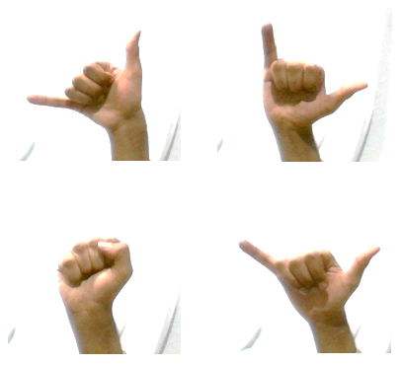
Results and Outputs
Gestures used:

Slide 12
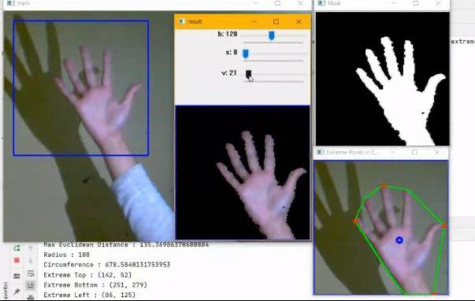
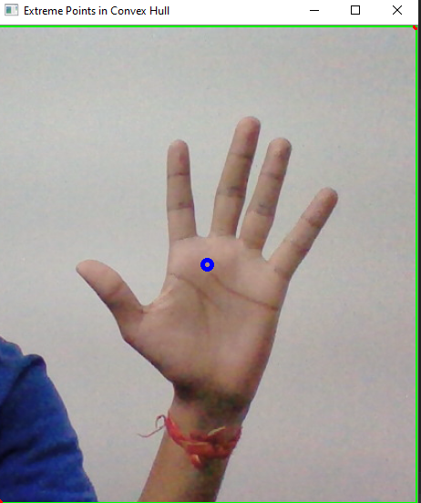
Results and Outputs
We used OpenCV to process the real time data.
After resizing the frame we took a subset of the frame namely our region of interest.
Then we blurred the region of interest and converted RGB into HSV color space.

Slide 13
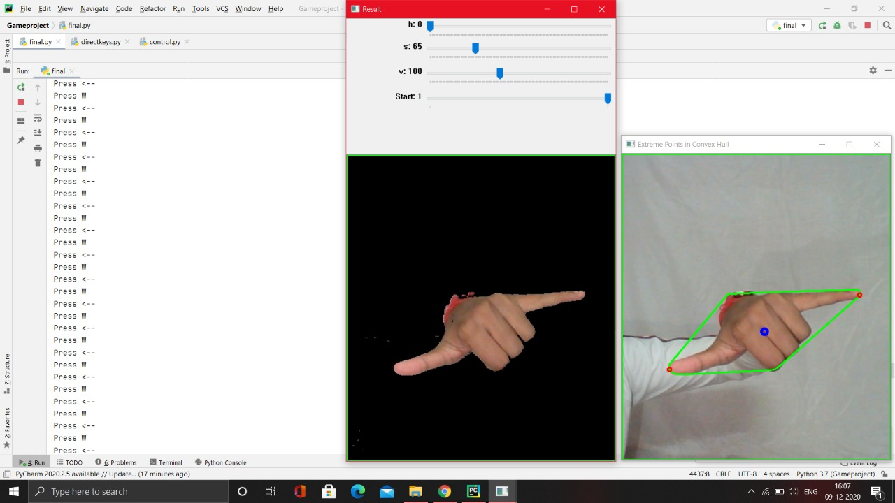
Results and Outputs (contd..)
We set the values of HSV using the track bar.
Then we used the HSV values as the lower skin values.
Then we masked the region of interest on the basis of lower and upper skin values.

Slide 14
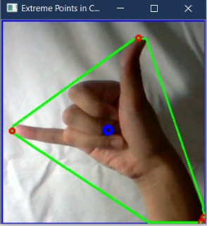
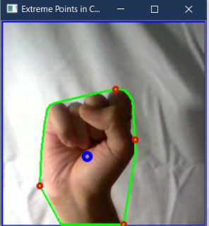
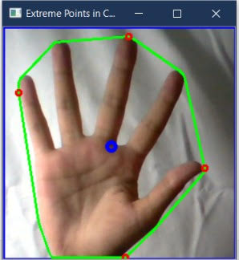
Results and Outputs (contd..)
Then we drew the contours which we further utilized in the concept of convexHull.

Slide 15
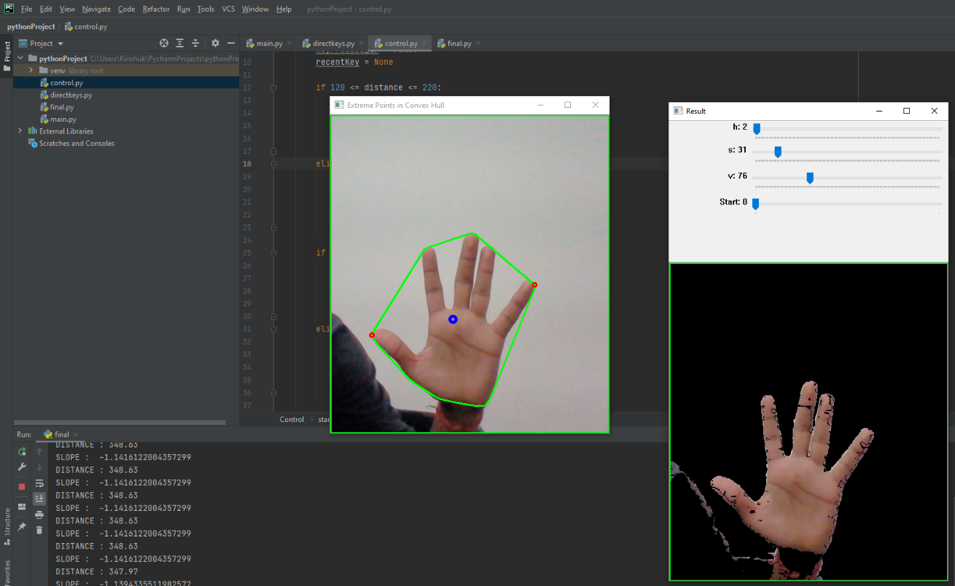
Results and Outputs (contd..)
We calculated the extreme left and right points using convexHull. Then we calculated the distance between the points and also the slope.
Then we passed the distance and slope value to another python script.

Slide 16
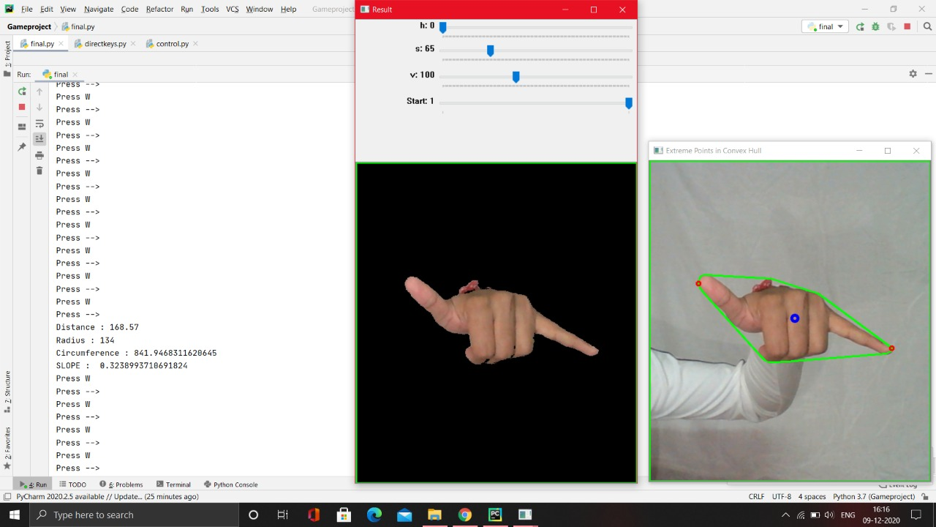
Results and Outputs (contd..)
Based on the distance we select key W or S.
Based on the slope we select key A or D.

Slide 17
Results and Outputs (contd..)
The skin detection code applied works very well and the user can select and adjust the HSV values according to his skin and illumination. Moreover, the shadows of hand do not disturb the working of code as shown below.

Slide 18
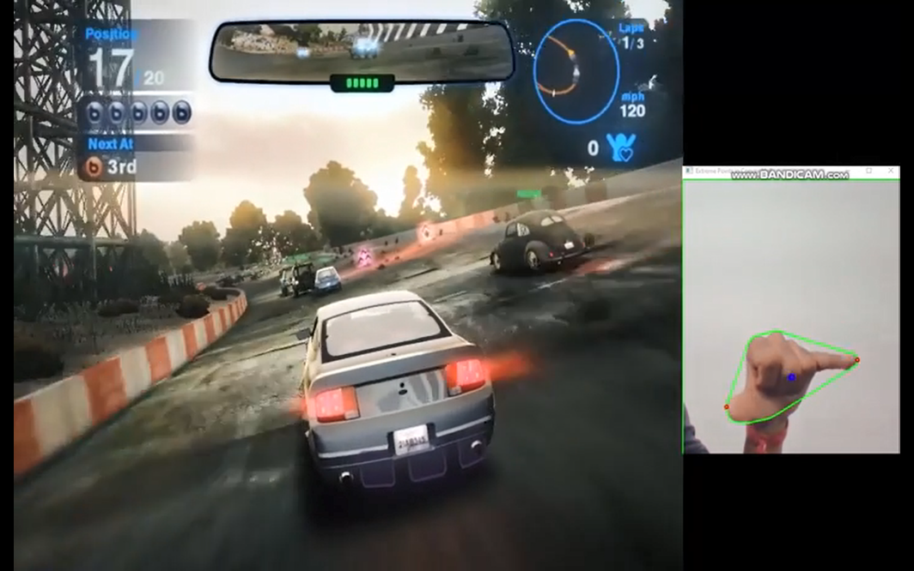
Results and Outputs (contd..)
The hand gestures have been mapped to the keyboard keys and the gesture controls works very well with the different games.
Implementation on Game: Blur

Slide 19
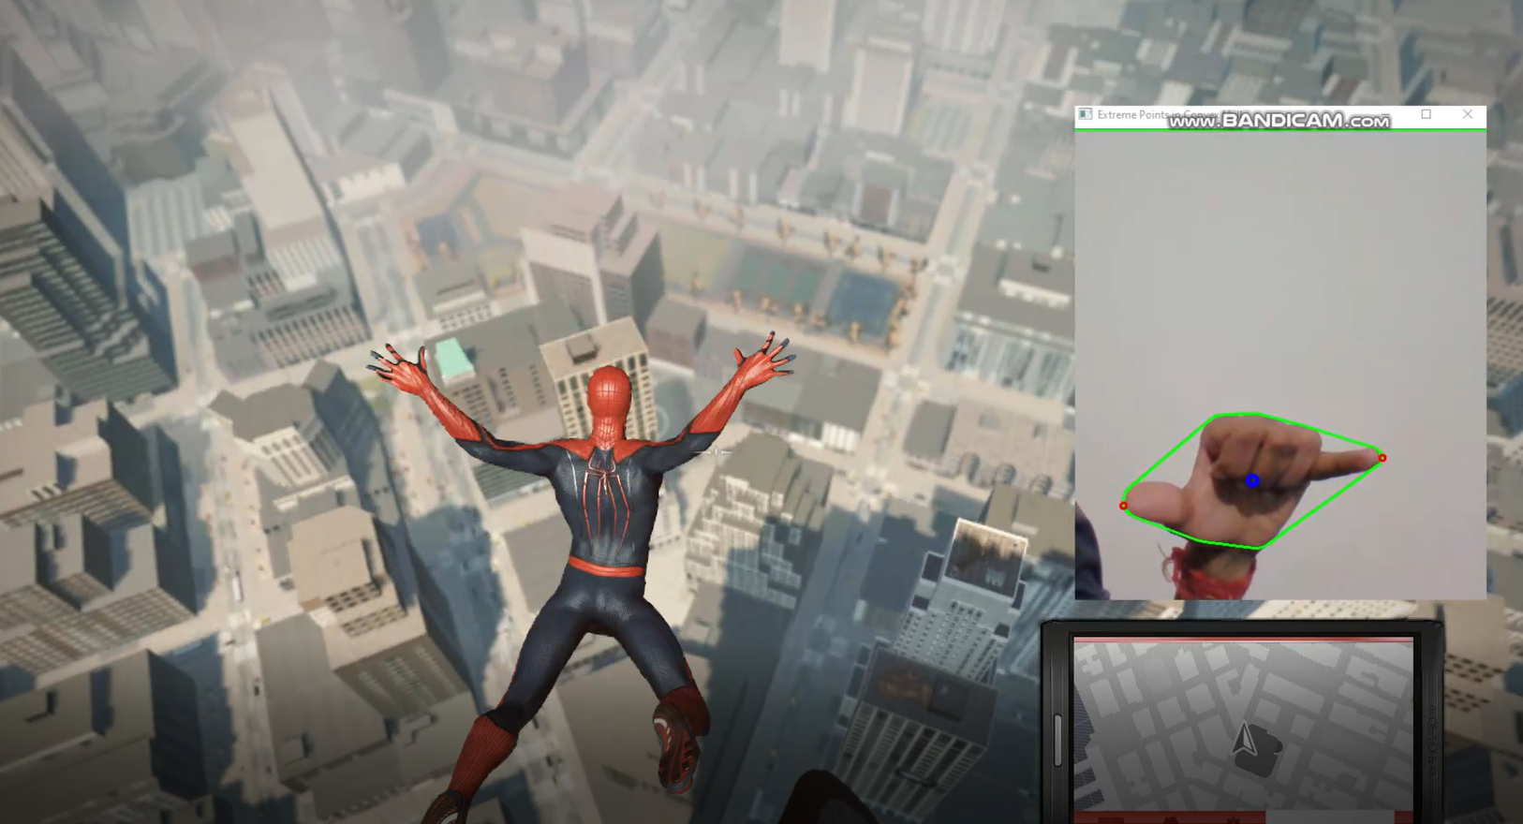
Results and Outputs (contd..)
Implementation on Game: Spiderman

Slide 20
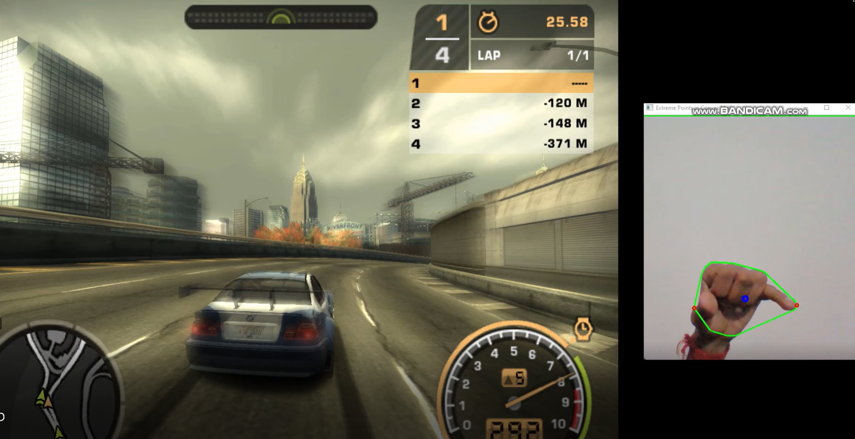
Results and Outputs (contd..)
Implementation on Game: Need For Speed (NFS)

Slide 21
Conclusion
The results also showed that the gesture recognition application was quite robust. However, the video version was enormously affected by the amount of illumination, such that is was necessary to check and adjust the HSV values for skin colour when starting the program to get the proper output. Sometimes the adjustment was difficult to do because of the lighting conditions and the amount of objects in the background.
The background must not be preferably within the skin color to get accurate results.
We achieved effective results by applying the application on different games.
Controlling things by hand is more natural, easier, more flexible and cheaper, and there is no need to fix problems caused by hardware devices, since none is required.

Slide 22
Future Scope
In a large-scale study, data could be collected and used to automatically identify player types based on their gesture interaction behaviour, and allow dynamic and automatic settings and mappings to optimize setups. This would allow the generation and mapping of gesture-based user types to speed up learning of interaction with the device easier.

Slide 23
References
Licsár, A.; Szirányi, T. User-adaptive hand gesture recognition system with interactive training. Image Vis. Comput. 2005, 23, 1102–1114.
Zhou, Y.; Jiang, G.; Lin, Y. A novel finger and hand pose estimation technique for real-time hand gesture recognition. Pattern Recognit. 2016, 49, 102–114.
Khandade, S.L.; Khot, S.T. MATLAB based gesture recognition. In Proceedings of the 2016 International Conference on Inventive Computation Technologies (ICICT), Coimbatore, India, 26–27 August 2016; Volume 1, pp. 1–4.
Pirker, Johanna & Pojer, Mathias & Holzinger, Andreas & Guetl, Christian. (2017).
Gesture-Based Interactions in Video Games with the Leap Motion Controller. Lecture Notes in Computer Science (including subseries Lecture Notes in Artificial Intelligence and Lecture Notes in Bioinformatics). 620-633
Kumar, B P Pradeep Kumar & C, Shivamurthy & B, Manjunatha. (2015). Gesture recognition based interactive car game, International Conference on Electrical, Electronics, Signals, Communication and Optimization (EESCO). IEEE, pp. 1–6.

